Slide 1
Cognitive Metrics Tool

Slide 2
Pre-Prod
Average Closure Time
Defect Average Retest Time
Defect Average Refix Rate
Defect Density
Containment
Defect Removal efficiency

Slide 3
Defect Average Retest Time

Slide 4
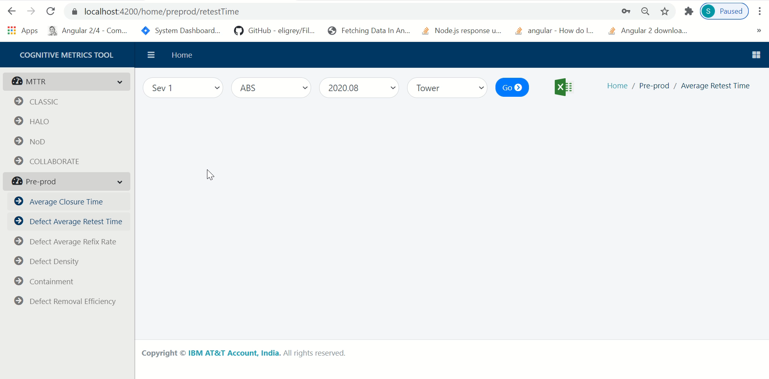

Slide 5
Application View

Slide 6


Slide 7
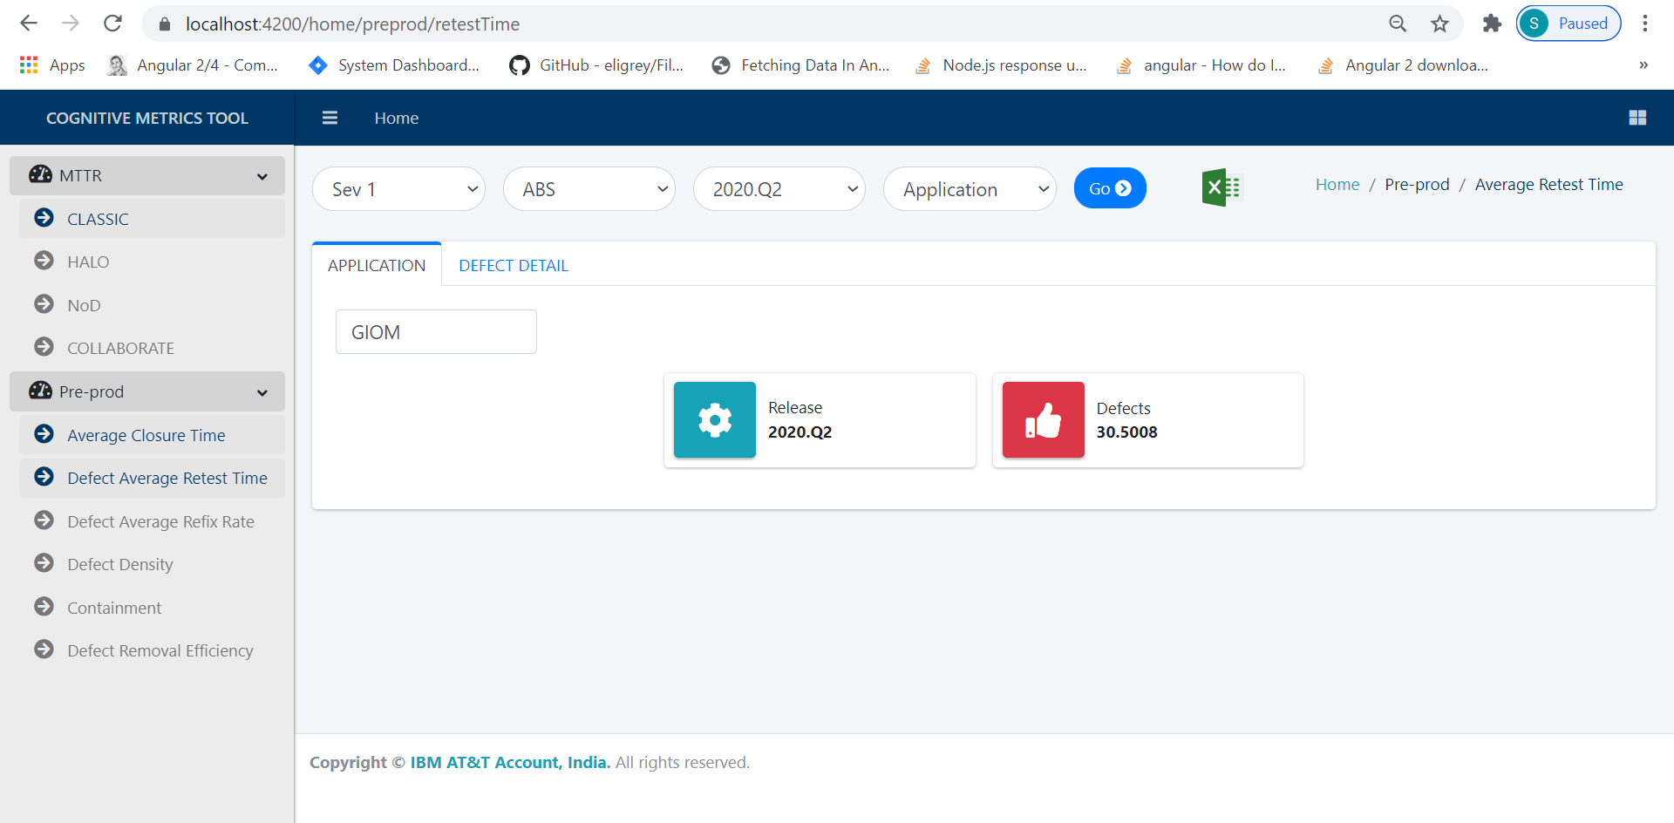

Slide 8
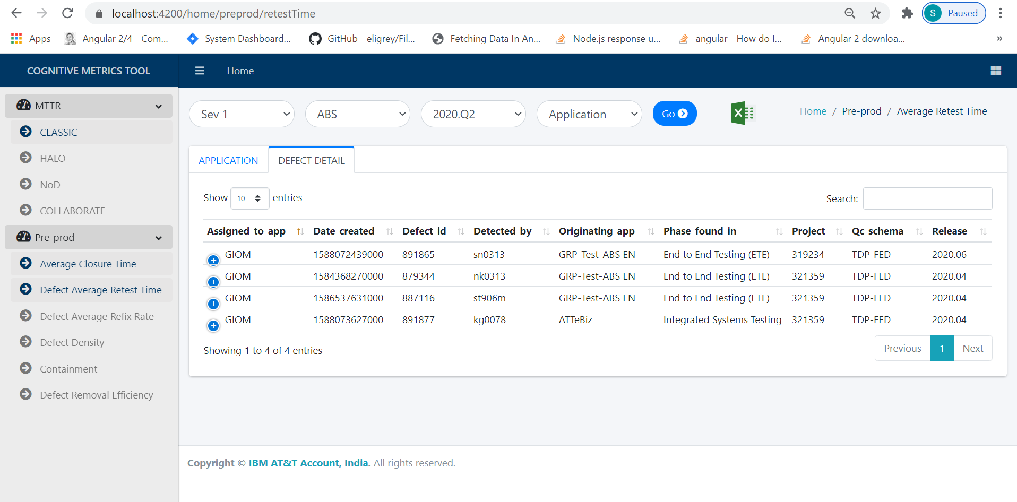

Slide 9
Tower View

Slide 10
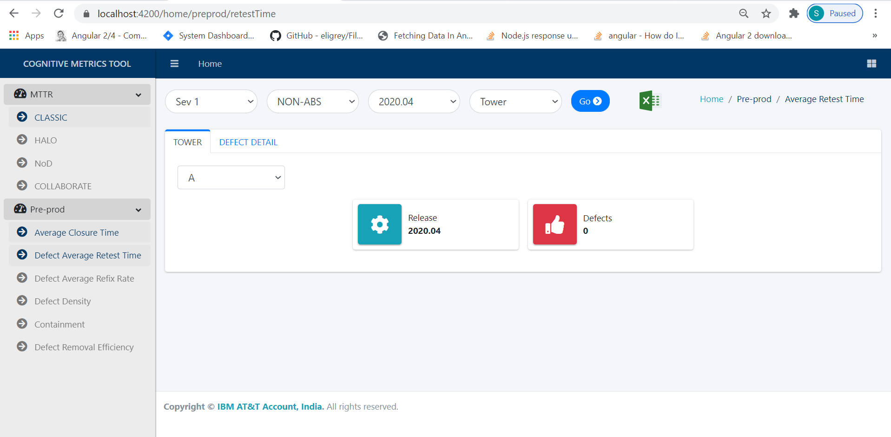

Slide 11
Account View

Slide 12
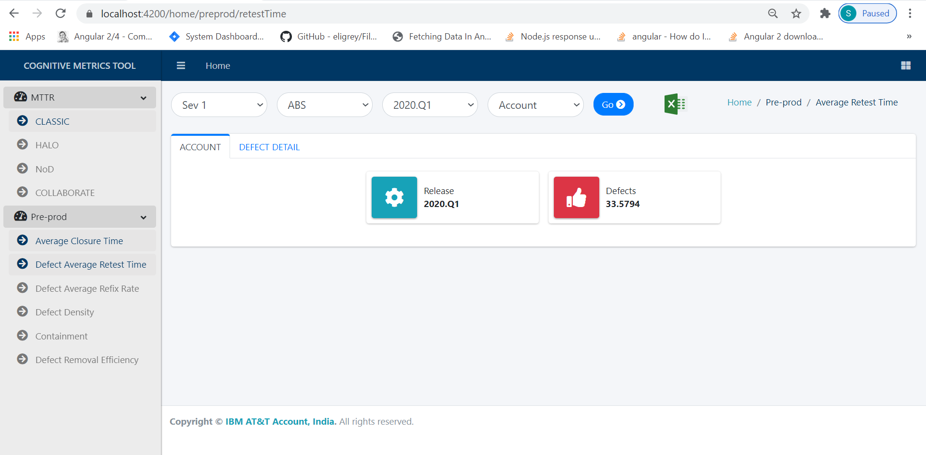

Slide 13
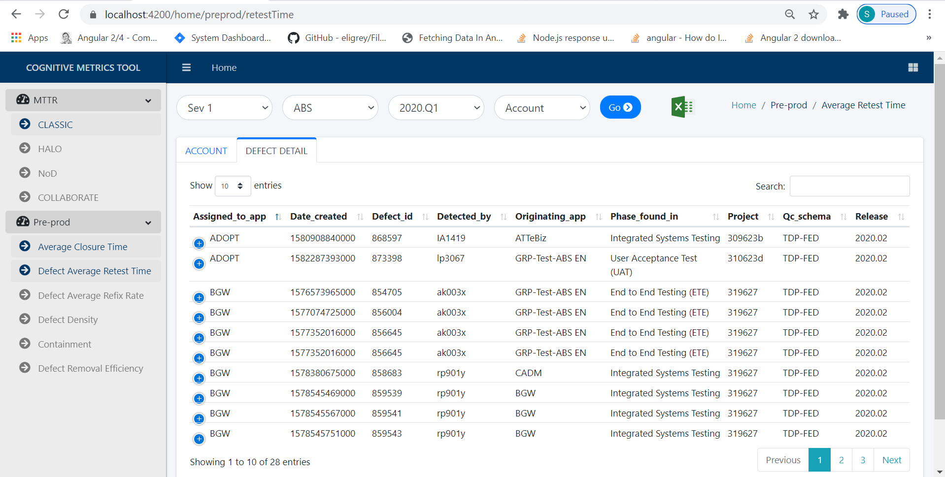

Slide 14
Thank You

